Slide 1


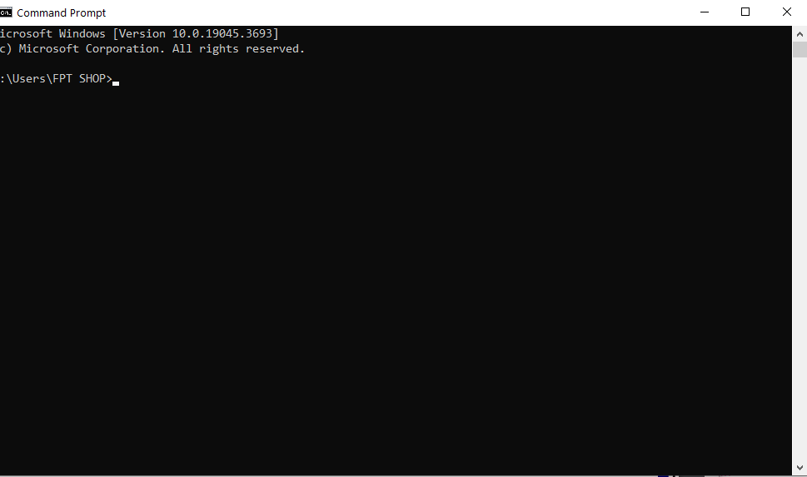

SEMESTER
231
COMPUTER SYSTEMS ENGINEERING (EE3401)
Write a simple text editor using the list ADT.
STUDENT
Nguyễn Nhật Tuấn Minh
Trương Minh Khôi
Lương Hoàng Phúc
Châu Hồng Phước
2151229
2151216
2010525
2051175
PROJECT

Slide 2
CONTENTS
01
02
03
04
Introduction
Theory
Code execution
Conclution and
Reference
Text editor
The List Abtract Data type
Define the single Link List structureProject Timeline
Implement the data structure operation
Implement the user’s command
Open file
Replace text
Delete text
Save file
NEXT

Slide 3



PART 1
Introduction

Slide 4



WHAT IS THE TEXT EDITOR AND LIST ADT?
A text editor is a software tool designed for creating and editing plain text files. It provides a simple and efficient interface for users to write and modify text-based content.
Text editors are widely used by programmers, writers, and anyone who needs to work with text-based documents.
NEXT

Slide 5
WHAT IS THE TEXT EDITOR AND LIST ADT?
Text editors come in various forms, ranging from basic editors that offer minimal functionality to advanced editors with powerful features and customizable options.
Some popular text editors include Notepad (Windows), TextEdit (Mac), and Visual Studio Code.
NEXT

Slide 6

The List Abstract Data Type (ADT)
ADT is a fundamental data structure in computer science that represents a collection of elements arranged in a specific order. It provides a way to store and manipulate a sequence of items, where each item can be accessed using its position or index within the list.

Slide 7
The List Abstract Data Type (ADT)
These operations typically include:
. Insertion: Adding an element to the list at a specified position.
. Deletion: Removing an element from the list at a specified position.
. Access: Retrieving the value of an element at a given position.
. Search: Finding the position of a specific element within the list.
. Update: Modifying the value of an element at a particular position.

Slide 8
The List Abstract Data Type (ADT)
The List ADT is fundamental in many programming languages and serves as a building block for more complex data structures like stacks, queues, and trees. It is widely used in various applications, including data processing, database management, and algorithm design

Slide 9
The List Abstract Data Type (ADT)
In summary, a simple text editor using the List ADT provides the basic functionality of creating, editing, and manipulating text-based content. By utilizing a linked list as the underlying data structure, the text editor can efficiently handle operations such as insertion, deletion, access, search, and update, enabling users to work with text in a flexible and intuitive manner.

Slide 10
SUMMARY
A simple text editor using the List ADT provides the basic functionality of creating, editing, and manipulating text-based content.
By utilizing a linked list as the underlying data structure, the text editor can efficiently handle operations such as insertion, deletion, access, search, and update, enabling users to work with text in a flexible and intuitive manner.
NEXT

Slide 11


PART 2
Theory

Slide 12
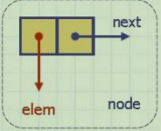
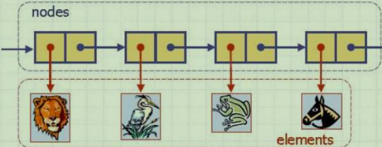
THEORY
Define the single Link List structure
Create a structure or class called `IntSLLNode` that represents a node in the linked list.
Each node should contain a character or a string to store the text data, as well as pointers to the next nodes.
NEXT

Slide 13
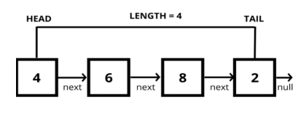
THEORY
Define the single Link List structure
Declare private member variables such as `head`, `tail`, and `size` to keep track of the linked list
NEXT

Slide 14
THEORY
Implement the data structure operation
To operate the data structure, we construct the function intSLL (mentioned in III part) as ‘insert’, ‘delete’, ‘move’, ‘replace’,…
In this program we have 3 different delete functions namely deleteFromTail , deleteFromHead, deleteNode which serve different purpose:
NEXT

Slide 15
THEORY
Implement the data structure operation
In this program we have 3 different delete functions namely deleteFromTail , deleteFromHead, deleteNode which serve different purpose:
insertNode(): To insert the new node in a specific positon in a linked list. deleteFromHead(): Removes the first node by updating the head pointer to the second node
deleteFromTail(): Removes the last node by updating the next pointer of the second-to-last node to NULL
NEXT

Slide 16

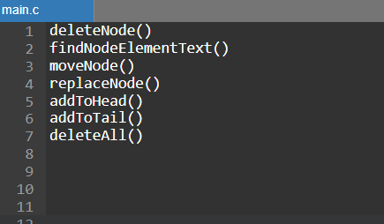
NEXT

Slide 17
THEORY
Implement the data structure operation
deleteNode(): Removes a specific node by updating the next pointer of the node before the node to be deleted to the after node. Then the delete the node.
findNodeElementText(): To find the node contain in a specific text in a linked list.
moveNode(,): To move a node from a current position to the new position in a linked list.
NEXT

Slide 18
THEORY
Implement the data structure operation
replaceNode(): To replace the current node for the new data in a linked list
addToHead(): To add the node to the first of a linked list
addToTail(): To add the node to the last of a linked list.
deleteAll(): To delete all nodes in a linked list.
NEXT

Slide 19
THEORY
To process the command from user, we construct the function ‘MyFunctions’
LeftTrim()
RightTrim()
SplitSringBySpaceToArray() SplitStringByDelimeter()
ToLowerCase()
Implement the user’s command
NEXT

Slide 20
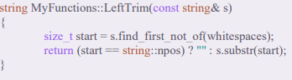
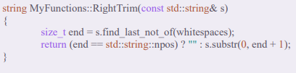
THEORY
For function ‘LeftTrim’ and ‘RightTrim’, it find the space in the command of user.
Implement the user’s command
NEXT

Slide 21
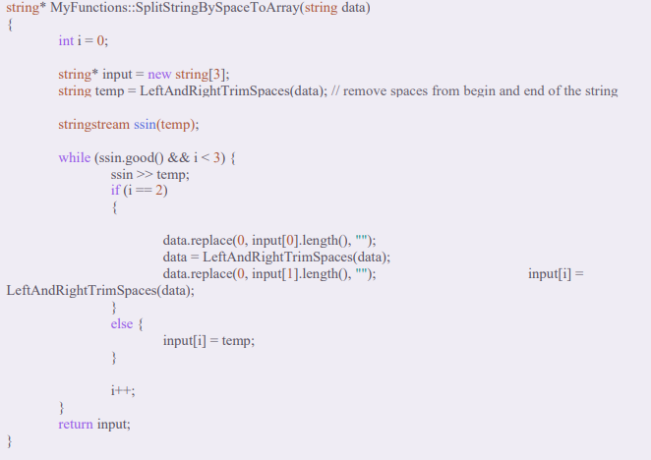
THEORY
Implement the user’s command
Function ‘SplitSringBySpaceToArray’, it splits the command into the parts to implement based on the space
NEXT

Slide 22
THEORY
The command that has 1 argument like ‘open text.txt’, we split it into 2 part “open” and “text.txt”
The command that has 3 argument like ‘insert 3 contend’(insert the contend into node 3) , we split it into 3 part “insert” ; “3” ; “contend”.
Implement the user’s command
NEXT

Slide 23
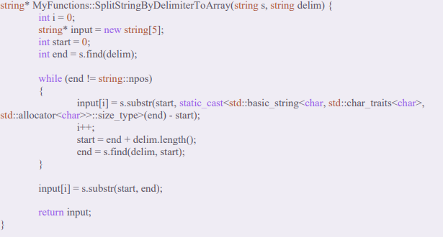
THEORY
Implement the user’s command
Function ‘SplitStringByDelimeter’, it process the nearest function in undoStack, its operation similar to SplitSringBySpaceToArray, but it work based on character “#” instead of the space
NEXT

Slide 24
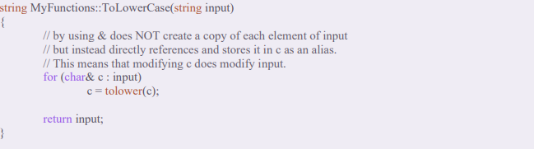
THEORY
Implement the user’s command
Function ‘ToLowerCase’ converts the command into lowercase so as to avoid user command case sensitivity error.
NEXT

Slide 25
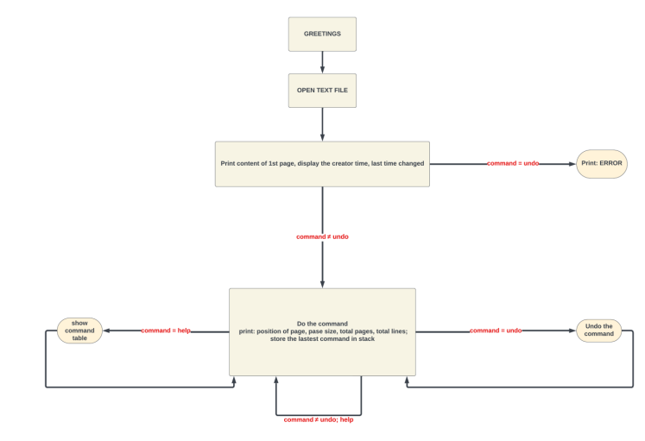
NEXT

Slide 26
















CODE EXECUTION
COMPILE AND RUN (F11)
11:11PM

Slide 27
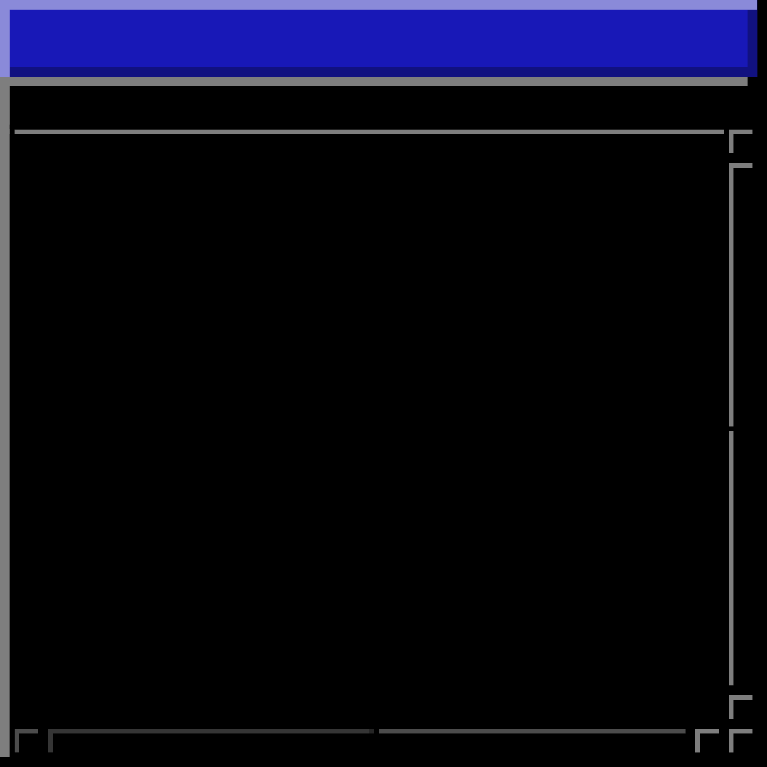
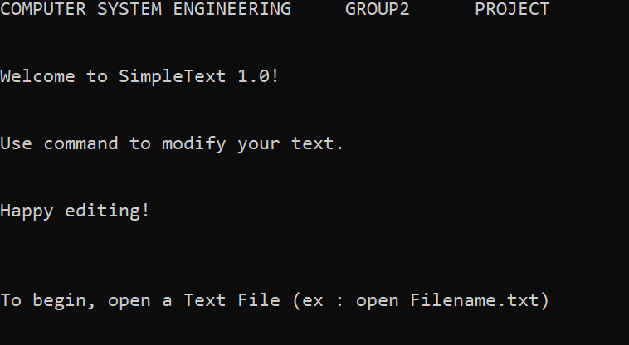

OPEN THE FILE
FOR EXAMPLE
We create a text document name “text.txt”
User need to use command to open file ‘open text.txt’
open text.txt
Back to Agenda Page

Slide 28
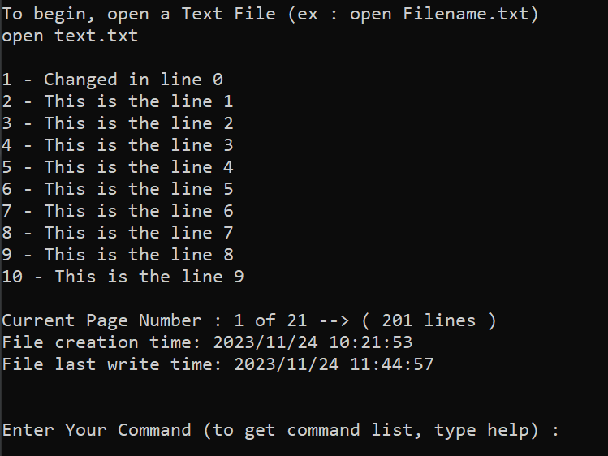
OPEN THE FILE
FOR EXAMPLE
We have implemented a stack to keep track of all actions carried out, so you can undo actions if needed. We also write a function to track the time that file was created as well as the time that file was written.
Back to Agenda Page

Slide 29
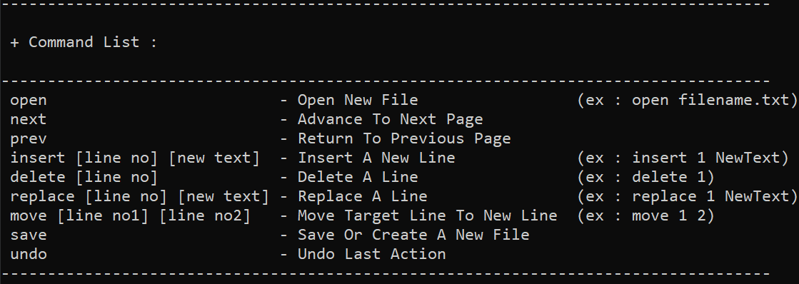
OPEN THE FILE
FOR EXAMPLE
We have implemented a stack to keep track of all actions carried out, so you can undo actions if needed. We also write a function to track the time that file was created as well as the time that file was written.
help
Back to Agenda Page

Slide 30
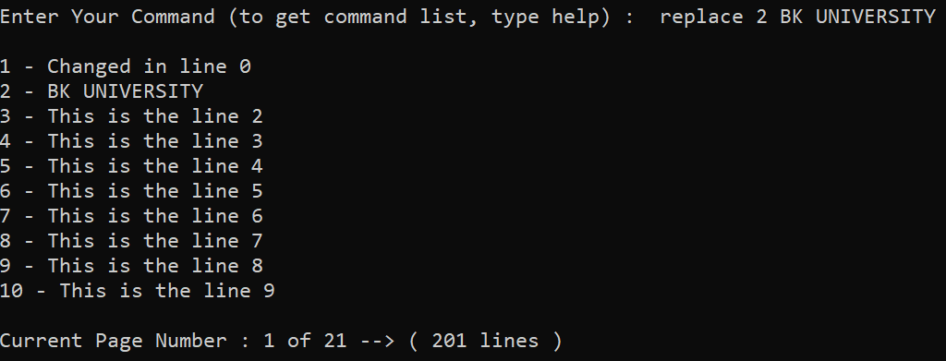
OPEN THE FILE
FOR EXAMPLE
replace 2 BK UNIVERSITY
Replace the test in line 2 by “BK UNIVERSITY”
Back to Agenda Page

Slide 31
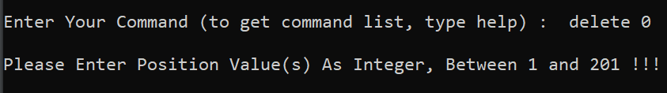
OPEN THE FILE
FOR EXAMPLE
Delete the text in line 0
delete 0
Back to Agenda Page

Slide 32
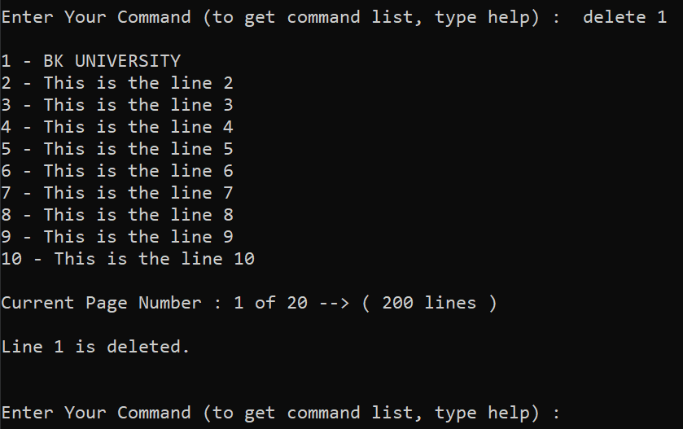
OPEN THE FILE
FOR EXAMPLE
Delete the text in line 1
delete 1
Back to Agenda Page

Slide 33
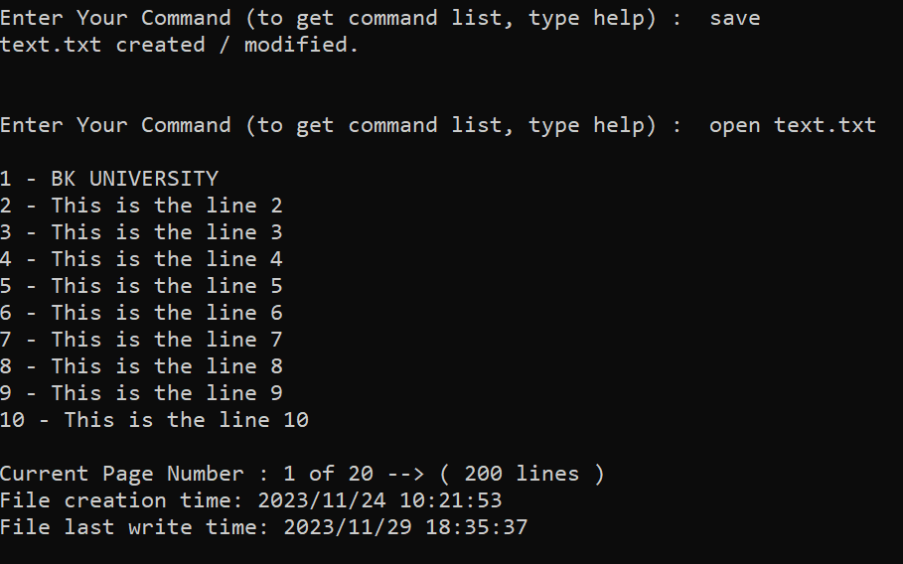
OPEN THE FILE
FOR EXAMPLE
Save and reopen the file
It can be seen that the content of the file has been updated
save
open text.txt
Back to Home Page

Slide 34
CONCLUSION
In conclusion, the implementation of a simple text editor using a list ADT has been a valuable learning experience. Through this project, we have explored the fundamental concepts of data structures and their practical applications. The text editor efficiently handles text manipulation operations such as insertion, deletion, and searching, showcasing the power and flexibility of the list ADT. By successfully creating a functional text editor, we have gained a deeper understanding of how data structures can be leveraged to build useful and intuitive software tools. This project serves as a solid foundation for further exploration and development in the field of data structures and C++ programming.
Back to Home Page

Slide 35
REFERENCE
1. Assoc. Prof. Truong Quang Vinh. (2023). Computer System Engineering. [Online]. Available: https://e-learning.hcmut.edu.vn/my/courses.php
2. “5.2. The List ADT — CS3 Data Structures & Algorithms,” opendsaserver.cs.vt.edu https://opendsaserver.cs.vt.edu/ODSA/Books/CS3/html/ListADT.html?fbclid=IwAR254dvV1 ycoxU_agwIP_0sxD2W82SXeiSoQbpma4jY-86fFSBdkh2Tteq8
(accessed Nov. 26, 2023).
Back to Home Page

Slide 36
THANK YOU

